Slide 1
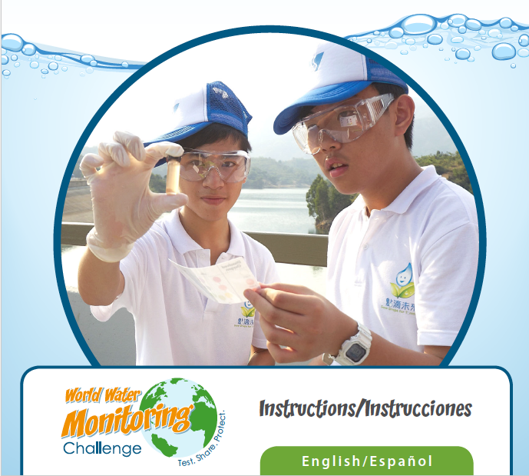
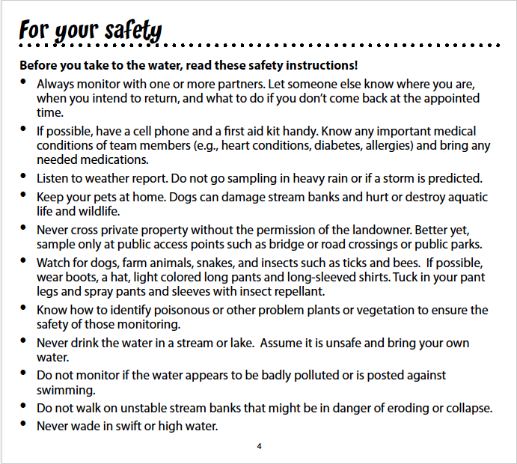
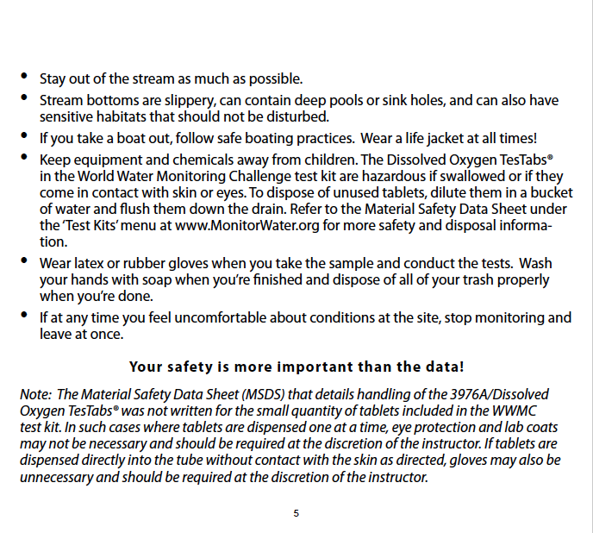
Background & Instructions
for Water Testing with
World Water Monitoring Challenge Testing Kits
Information presented here is taken and supplemented from the instructions provided with the kits manufactured by the LaMotte Company
http://www.monitorwater.org/
Original LaMotte instructions available online (PDF) at:
http://www.monitorwater.org/uploadedFiles/Content/Resources/English-Spanish_Instructions.pdf
SAFETY FIRST!!!
Safety instructions should be modified to fit your students, your sampling situation
This handout prepared by L. Guertin, Penn State Brandywine

Slide 2
Materials and tests you can do at
Ridley Creek – you decide!
You will have the ability to test for the following: air temperature, water temperature, dissolved oxygen, pH, turbidity, stream velocity, and stream discharge.
*hint – think of something you can test at more than one location along this stretch of Ridley Creek
Make a CLAIM(s) you will test.
What is your EVIDENCE?
What is your REASONING?

Slide 3
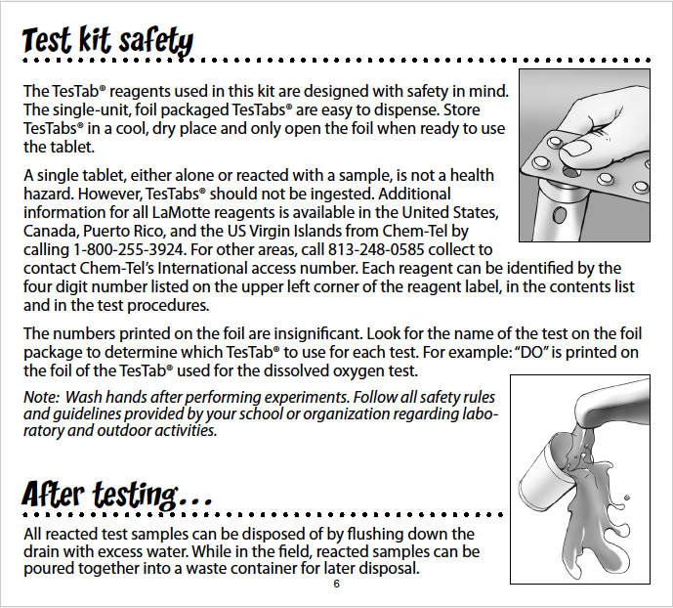
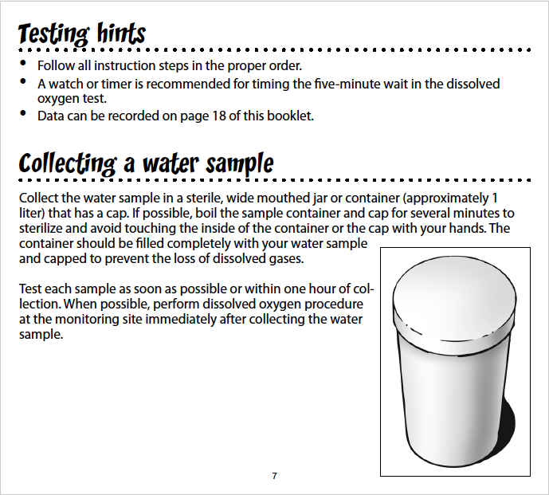

Slide 4
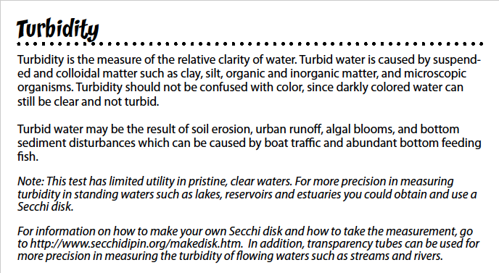
To prepare for field sampling (after reviewing safety tips):
View Water Testing Tutorial videos on World Water Monitoring Challenge YouTube channel: http://bit.ly/wwmcvideos
Decide where you will go to do your testing, confirm why you are going to those locations
Be sure you have all of the equipment/materials you need to do the testing.

Slide 5
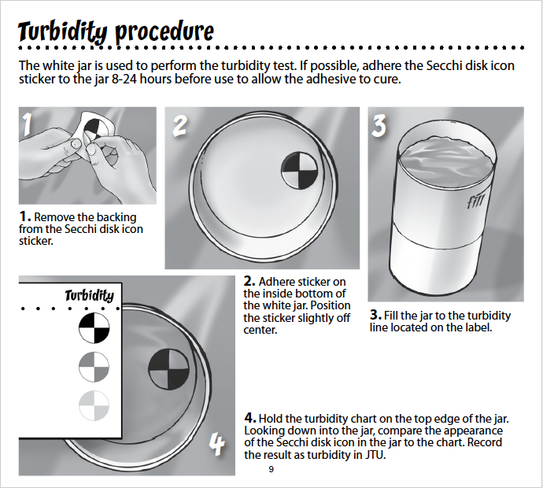
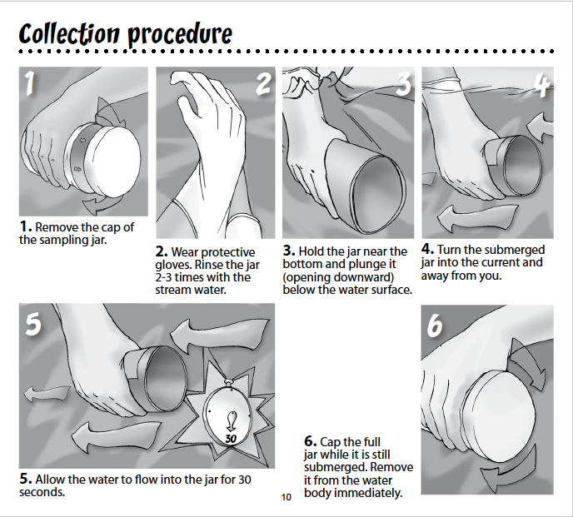

Slide 6
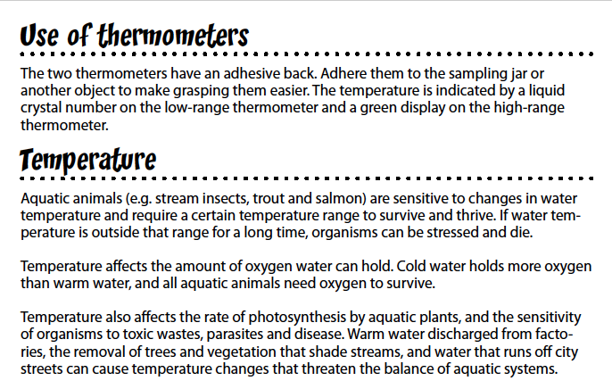
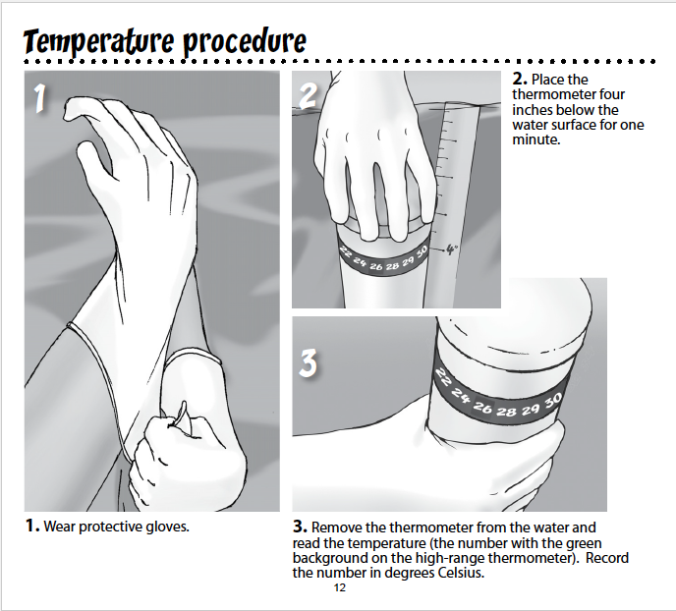

Slide 7
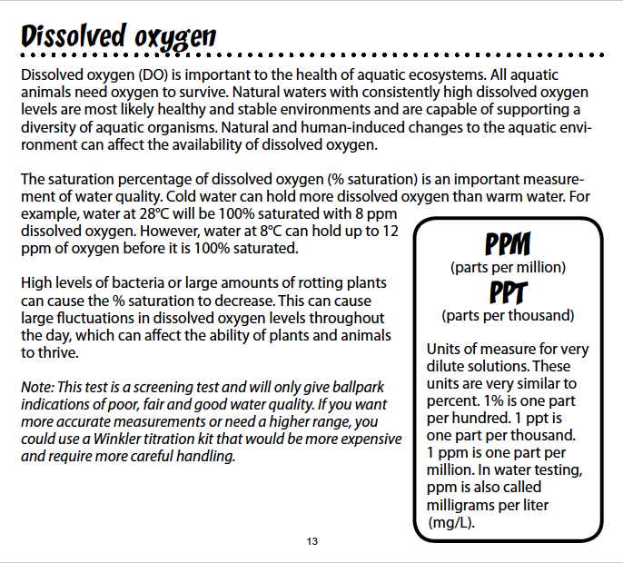
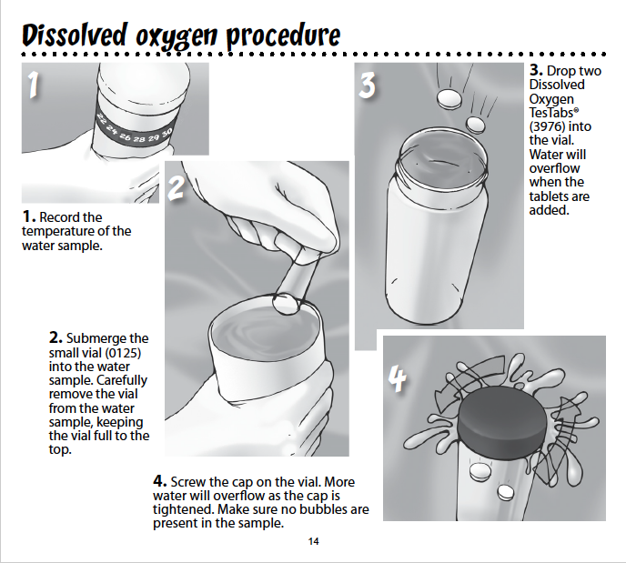

Slide 8
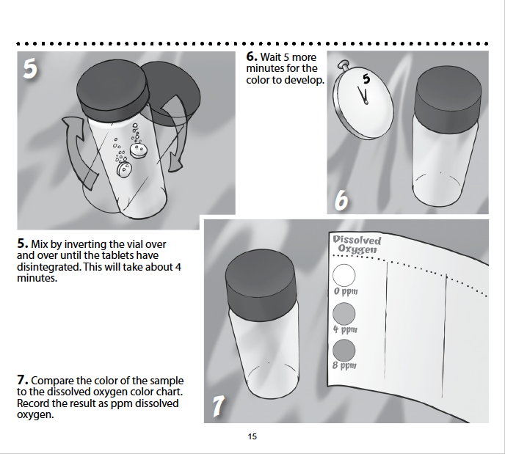
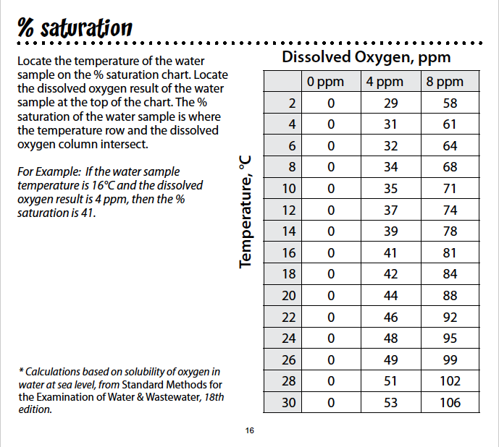

Slide 9
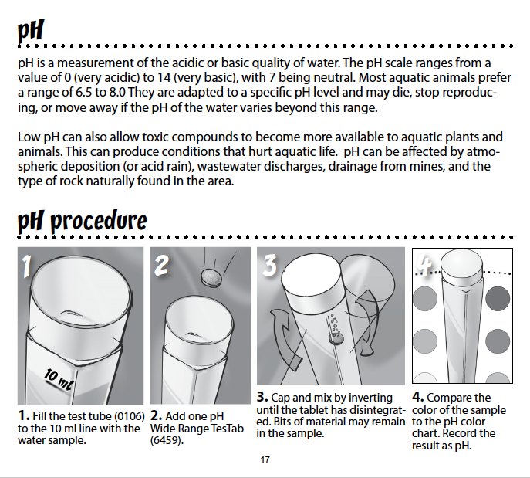
On the next page is a spreadsheet to record your data.
Upon return to the classroom, you should enter your data into the World Water Monitoring Challenge website! To register on the WWMC website and enter your data, visit:
Video tutorials: http://bit.ly/wwmcdataentry
Log in to website: http://app.monitorwater.org/

Slide 10
Date: ________________
Team members:
Parameter | Site A | Site B | Site C | Site D | Site E
Location
Time of data collection
Air Temperature
Water Temperature
Dissolved Oxygen
pH
Turbidity
Stream Velocity
Stream Discharge
Field notes:

