Slide 1
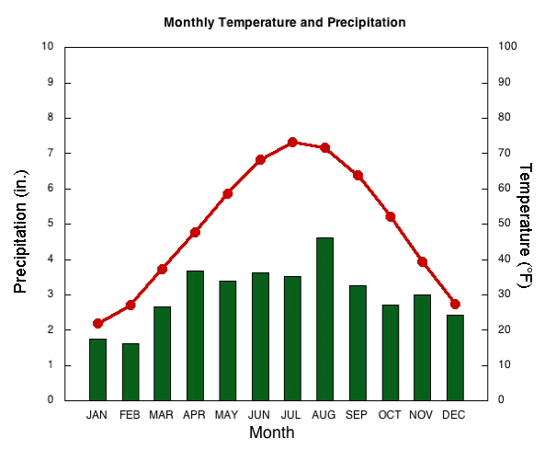
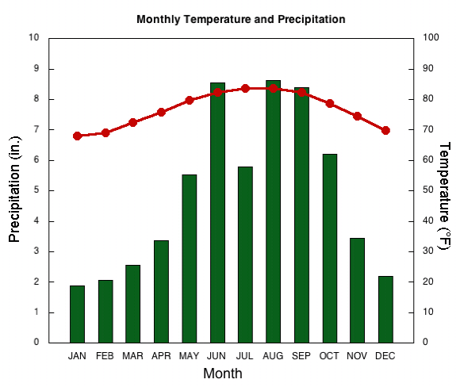
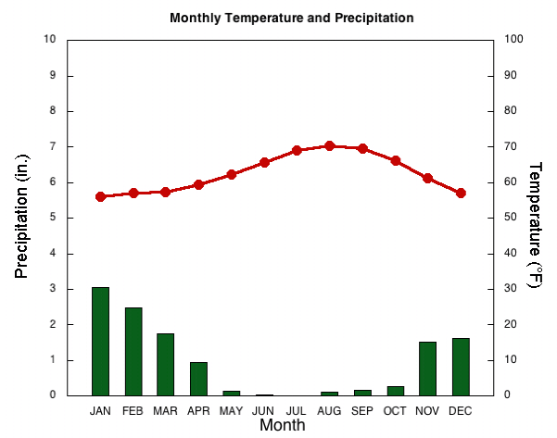
Climographs from the
National Drought Mitigation Center
A
Graphs accessed from:
http://drought.unl.edu/DroughtBasics/WhatisClimatology/ClimographsforSelectedUSCities.aspx
Climographs are a graphic way of displaying climate information - specifically, average temperature and precipitation - for a particular location
B
C

Slide 2
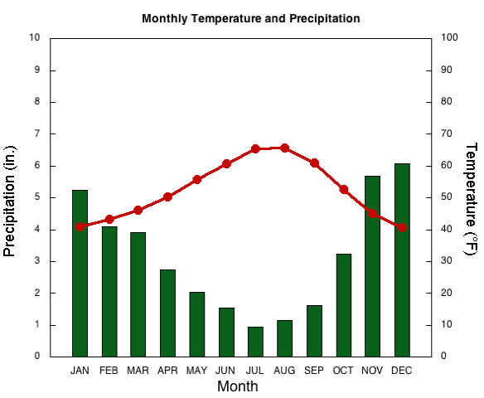
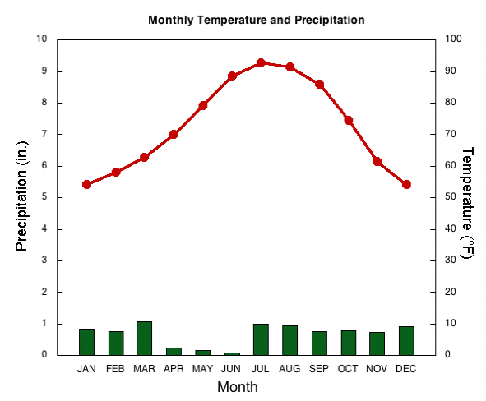
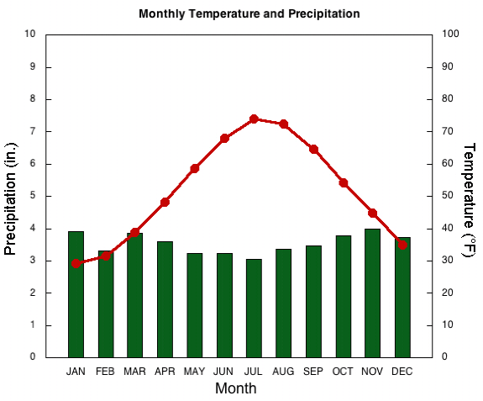
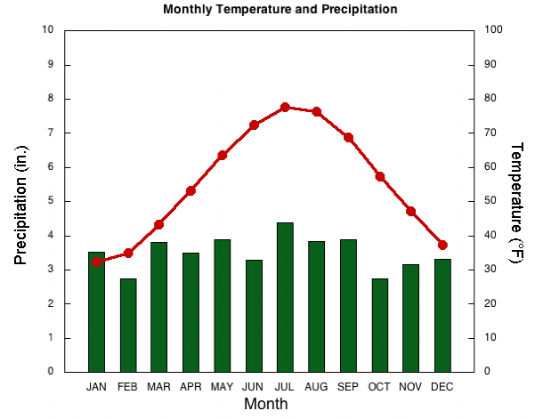
D
E
G
F

Slide 3
 | A | B | C | D | E | F | G
List the coldest and warmest months
Degree difference between warmest & coldest month?
Which business would you rather own – air conditioning or heating?
Could you grow grapefruits & oranges?
How many seasons of clothing would you own – 2 or 4?
Would you play ice hockey indoors or outdoors?
Would outdoor swimming pools be common here?
Would roofs be flat or pitched (at an steep slope)?
List which month has highest monthly rainfall and the value (in inches)
Rank all locations 1 (lowest) to 7 (highest) for average yearly rainfall
YOUR CITY
Notes:
What are the trends that can be seen in a climograph and what do they tell us about the particular climate that is being studied?
A = Chicago; B = Miami; C = Los Angeles; D = Seattle; E = Phoenix; F = Boston; G = Philly

