Slide 1
From http://drought.unl.edu/DroughtBasics/WhatisClimatology.aspx
Weather is the condition of the atmosphere over a brief period of time. For example, we speak of today’s weather or the weather this week. Climate represents the composite of day-to-day weather over a longer period of time.
Climate is usually defined by what is expected or “normal”, which climatologists traditionally interpret as the 30-year average. By itself, “normal” can be misleading unless we also understand the concept of variability.
The misconception that weather is usually normal becomes a serious problem when you consider that weather, in one form or another, is the source of water for irrigation, drinking, power supply, industry, wildlife habitat, and other uses. To ensure that our water supply, livelihoods, and lives are secure, it is essential that planners anticipate variation in weather, and that they recognize that drought and flood are both inevitable parts of the normal range of weather.

Slide 2
In the most general sense, drought originates from a deficiency of precipitation over an extended period of time--usually a season or more--resulting in a water shortage for some activity, group, or environmental sector.
Its impacts result from the interplay between the natural event (less precipitation than expected) and the demand people place on water supply, and human activities can exacerbate the impacts of drought.

Slide 3
US Drought Monitor http://droughtmonitor.unl.edu/
Drought for Kids
http://drought.unl.edu/DroughtforKids.aspx

Slide 4
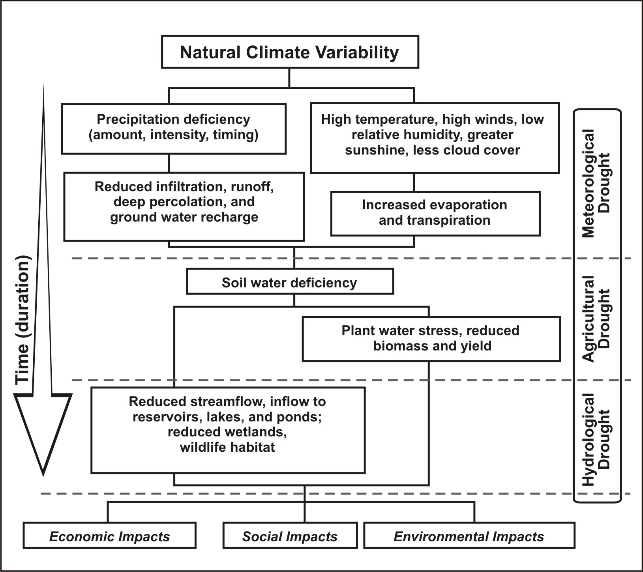
Sequence of drought occurrence and impacts for commonly accepted drought types. All droughts originate from a deficiency of precipitation or meteorological drought but other types of drought and impacts cascade from this deficiency. (Source: National Drought Mitigation Center, University of Nebraska-Lincoln, U.S.A.). Image from: http://drought.unl.edu/DroughtBasics/TypesofDrought.aspx

Slide 5
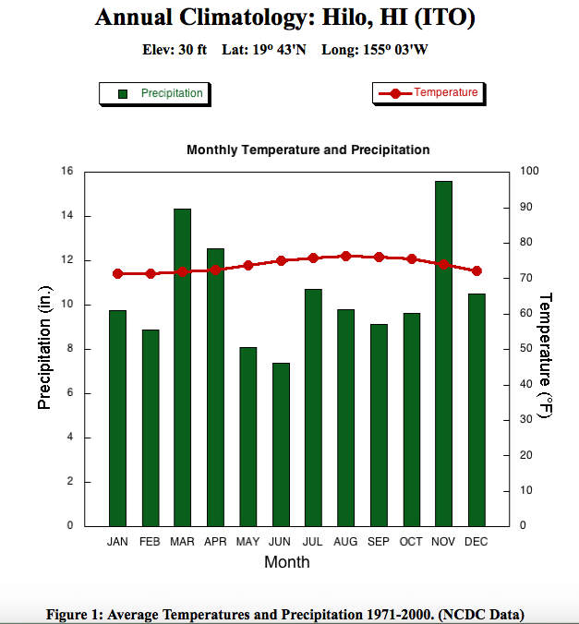
Climographs for U.S. Cities:
http://drought.unl.edu/DroughtBasics/WhatisClimatology/ClimographsforSelectedUSCities.aspx

